Slide 1

Sniffing Packet Sniffers
ENPM697
Omar Abdelati UID: 117556827

Slide 2
Introduction - Guiding Questions
What sniffers are?
How do they work?
What are the different environments in which they work?
How can we identify a sniffer?
Can course of action against a sniffer?
Notes:
Focusing on packet sniffers operating in a shared ethernet environment

Slide 3
What is a sniffer and how does it work?

Slide 4
Quick reminder - Sniffers
Program or device that intercepts network traffic
Idea of ethernet: To share using broadcast technology
Reality: Computers will ignore/drop packets that are not intended from them
Network Interface Controller (NIC) runs on promiscuous mode to intercept all packets in network traffic
Examples of sniffers: tcpdump, wireshark and ettercap

Slide 5
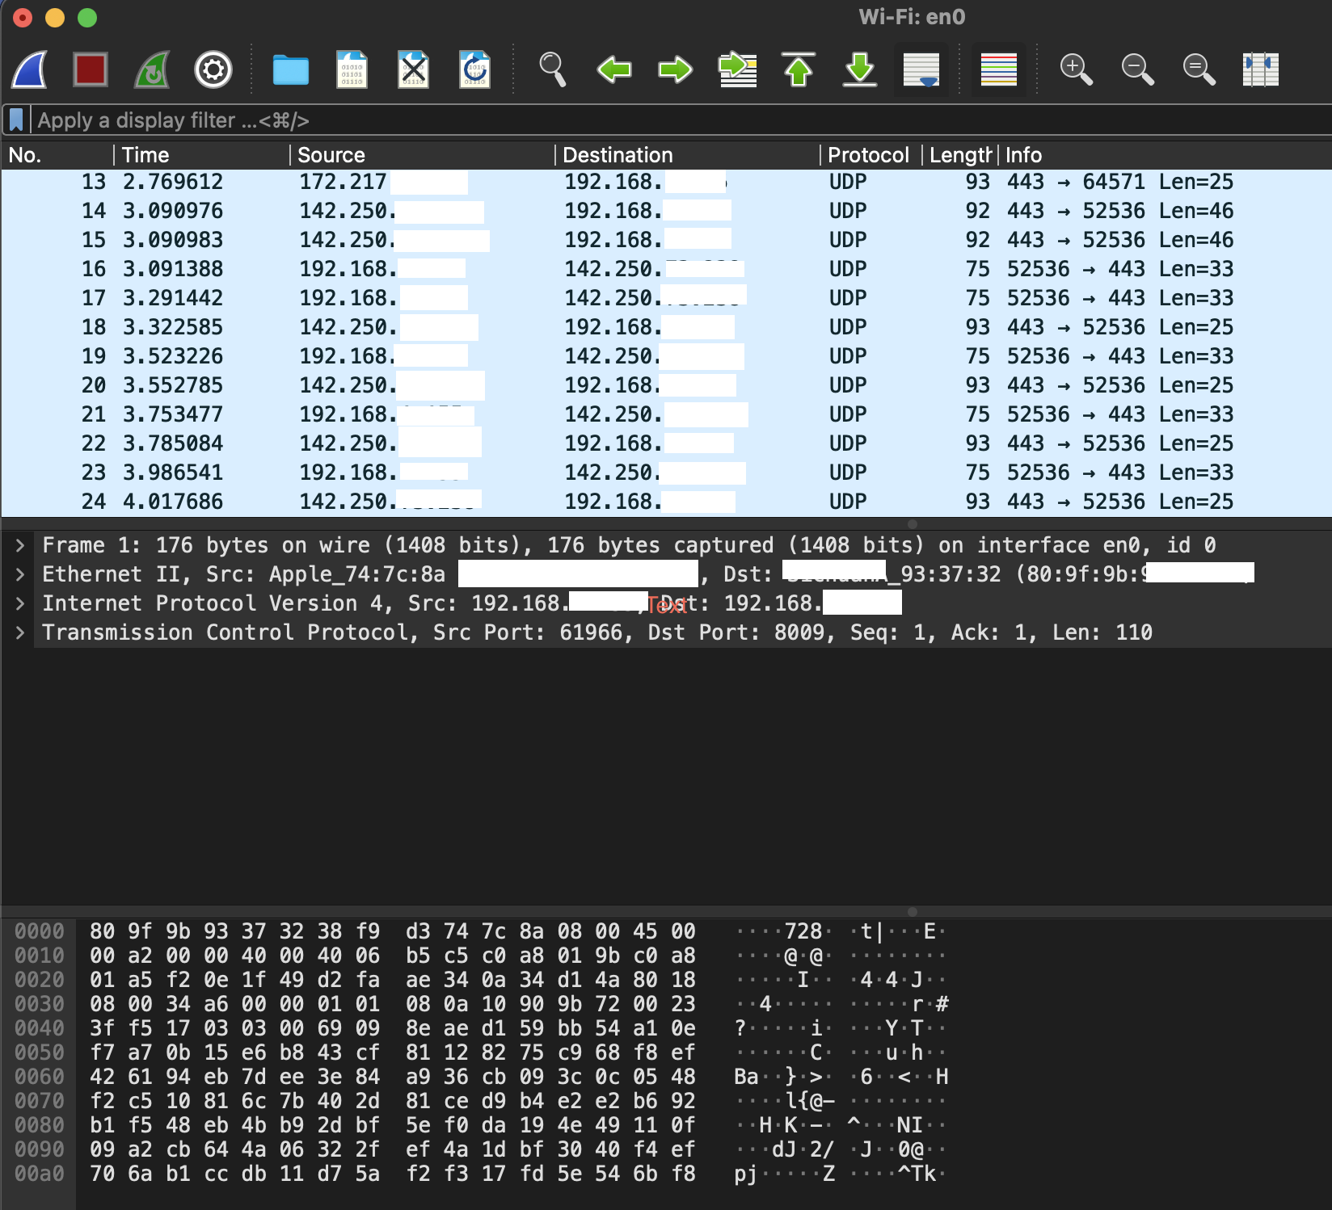
Wireshark Example

Slide 6
How do they work? - Sniffers
Computers have two addresses
MAC
IP
Data link layer uses MAC address to resolve destination machine
Network layer maps IP to MAC address
Looks up MAC address in ARP (Address Resolution Protocol) cache
If there is no entry for the IP address, ARP broadcasts request packet to all machines on network
Machine in question will respond to the broadcast with MAC address
MAC address is added to source machine’s ARP cache
Source machine uses this MAC address in all future communications
Notes:
Mac address used in ethernet protocol to transfer data to and from a machine
IP address used by applications,

Slide 7
Where can sniffers operate?
Ethernet Environments
Shared Ethernet
All hosts connected to the bus
Easier to sniff
Switched Ethernet
Misconception: Network switches are invulnerable to sniffing
Does not broadcast
Maps MAC addresses to physical ports
Switch resolves MAC address destinations using its physical ports
Notes:
Switched Ethernet is still vulnerable to Arp Spoofing and MAC Flooding.

Slide 8
Difficulty in Detecting Packet Sniffers
Easier to detect network sniffing in a switched network
To sniff a switched network, sniffers often spoof ARP requests or MAC flood
Harder to detect network sniffing in a shared network
Various Methods of detecting sniffers:
Ping Method
ARP Method
On Local Host
Latency Method
ARP Watch
Intrusion Detection System
Focus of this presentation
Notes:
Switched Ethernet is still vulnerable to Arp Spoofing and MAC Flooding.

Slide 9
Sniffing Packet Sniffers - Ping Method
Assumption: Sniffer’s IP address is known
Brute-force: Send to all machines on the network using their IP address
Send an ICMP packet to the sniffer’s IP with no MAC address
If the target IP is not a sniffer then the packet will be dropped
Since the MAC address does not match
Remember ethernet frame, with MAC address, is unpacked before IP
Sniffer is running on promiscuous mode
Should accept the packet regardless of the MAC address
Will find that the packet was addressed to itself
Responds to the ping with reply exposing itself as a sniffer

Slide 10
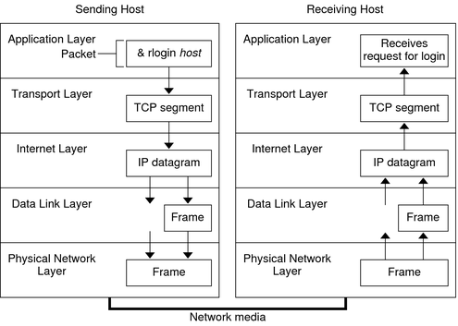
Packet Sniffer Detector
Packet Sniffer
Unpacks the IP datagram and realizes the packet was addressed to the current machine
Promiscuous Mode is on, therefore, machine accepts regardless of MAC
Sourced Example Picture

Slide 11
Sniffing Packet Sniffers - Ping Method
Obsolete
Not very reliable
Sniffers can avoid this method of detection using filtration

Slide 12
Sniffing Packet Sniffers - Ping Method Demo
Video plays here. Or I give the demonstration.

Slide 13
Sniffing Packet Sniffers - ARP Method
Assumption: Detector’s MAC address is still unknown to other hosts on the network
Utilizes concept: Machine ARP caching
Detector: Sends out non-broadcast ARP
Sniffer: Caches the ARP address
Detector: Broadcasts a ping with its IP address and different MAC address
Sniffer: Responds to detector’s broadcast ping
This happens because the sniffer has updated/added an entry on its ARP cache from the detector’s non-broadcasted ARP

Slide 14
Packet Sniffer Detection Tools
Snort
ARP Watch
Anti Sniff
Neped

Slide 15
Closing Remarks
Detecting packet sniffers can be very difficult, even with the tools mentioned on the previous slide. A lot of network administrators have shared their fear with dealing with packet sniffers. As sniffing detection becomes finds more intelligent ways to discover sniffers, packet sniffers will find more ways of evasion.
The truly best method of sniffer detection is encryption. Using SSH, HTTPS, any program that includes the recommended minimum level of encryption in its transport protocol and data. This limits the amount of data extraction a sniffer can have.

Slide 16
References
Dhar, S., n.d. Sniffers Basics and Detection.
Nasir Khan, A., Qureshi, K. and Khan, S., 2012. An Intelligent Approach of Sniffer Detection. In: The International Arab Journal of Information Technology. [online] Abbottabad, Pakistan: The International Arab Journal of Information Technology, p.7. Available at: <https://www.idc-online.com/technical_references/pdfs/information_technology/An%20Intelligent%20Approach.pdf> [Accessed 28 April 2021].
Trabelsi, Z. and Rahmani, H., 2004. Detection of Sniffers in an Ethernet Network. [ebook] El Ghazala, Ariana, Tunisia: Springer-Verlag Berlin heidelberg, p.13. Available at: <https://www.researchgate.net/profile/Zouheir-Trabelsi/publication/220905310_Detection_of_Sniffers_in_an_Ethernet_Network/links/57050e4508ae13eb88b93af2/Detection-of-Sniffers-in-an-Ethernet-Network.pdf> [Accessed 4 May 2021].
Trabelsi, Z., Rahmani, H., Kaouech, K. and Frikha, M., 2004. Malicious Sniffing Systems Detection Platform. In: International Symposium on Applications and the Internet. [online] El Ghazala, Ariana, Tunisia: IEEE, p.7. Available at: <https://www.cse.scu.edu/~tschwarz/COEN152_06/Lectures/01266117.pdf> [Accessed 4 May 2021].
Picture on slide 10: https://docs.oracle.com/cd/E18752_01/html/816-4554/ipov-29.html

